Slide 1
Renewable Energy Association
Date, 2020

Slide 2
OUR MISSION
To reduce UCLA’s environmental impact through student-driven projects that promote and develop clean-energy solutions

Slide 3
01
02
GENERAL INFO
MEET THE BOARD
03
04
PROJECTS
EVENTS
Our accomplishments and goals
Our roles and responsibilities
Our community and technical projects
Our flagship events

Slide 4
01
General Info

Slide 5
HISTORY OF REA
2013
2018
2019
First engineering organization dedicated to the environment
Secured $200,000 in grant funding to expand UCLA solar installations
Waste Awareness Week named the UCLA Sustainability Event of the Year

Slide 6
REA Moving Forward
Growing into an interdisciplinary organization with over 300 participating students
Partnering with fellow environmental organizations on UCLA sustainability initiatives
Adapting constantly to suit the needs of our members and the UCLA campus

Slide 7
02
Meet the board

Slide 8
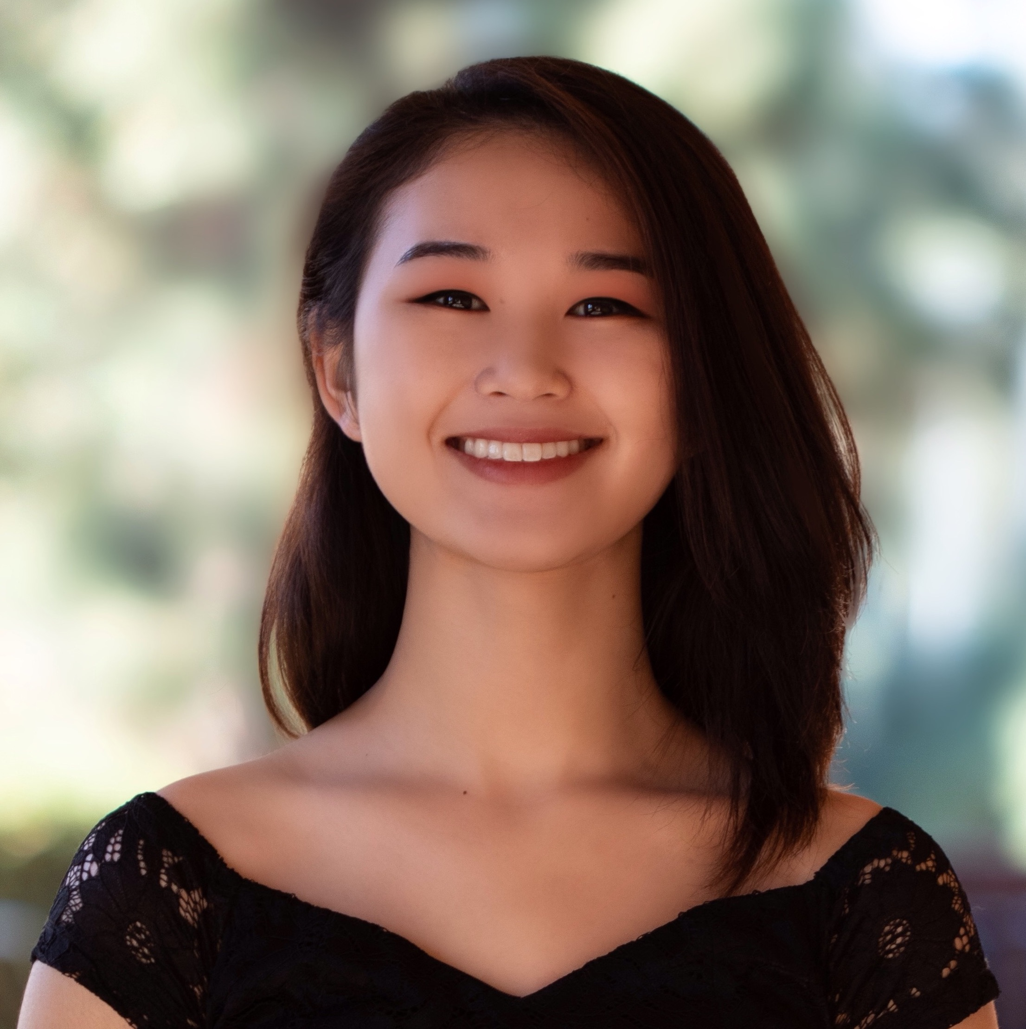
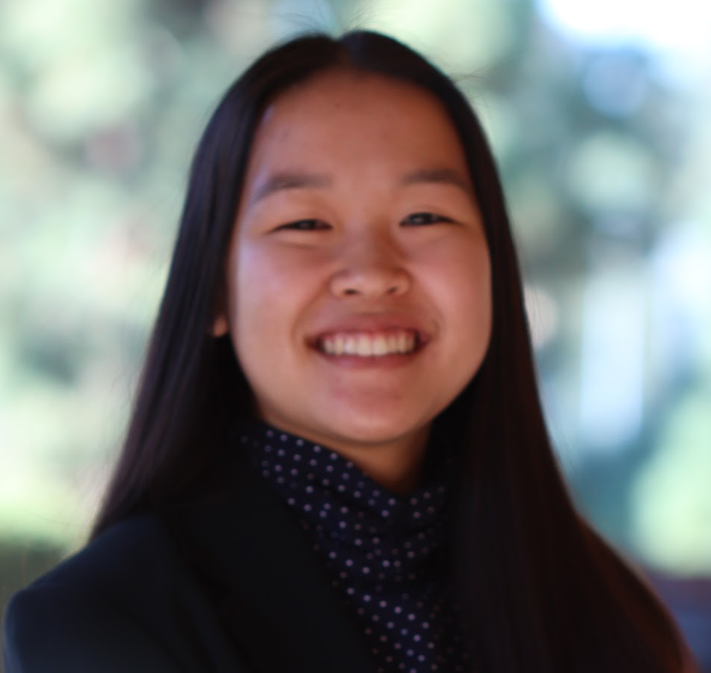
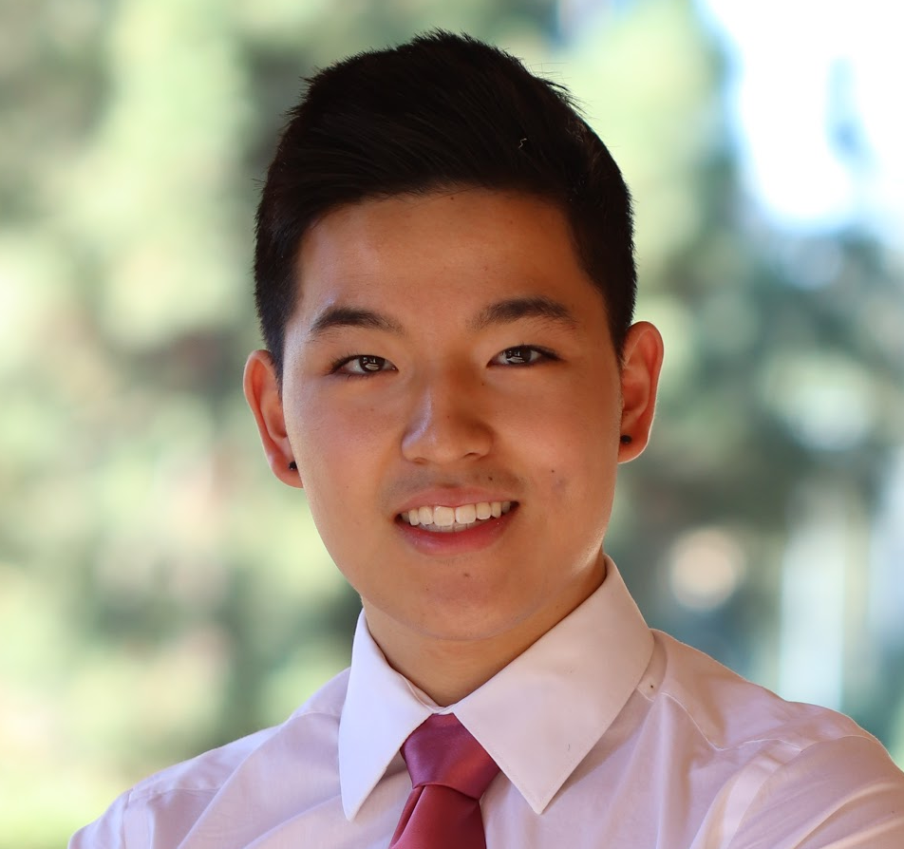
THIS IS
OUR
TEAM
KAYLI MASUDA
JOANNA YANG
TIM CHAO
President
3rd Year ChemE
External Vice President
3rd Year MSE
Internal Vice President
3rd Year ChemE

Slide 9
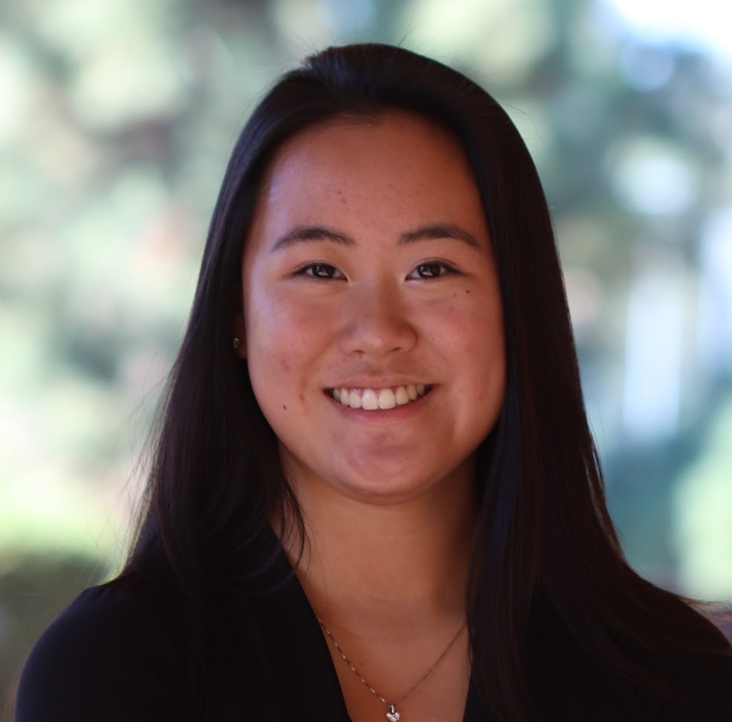
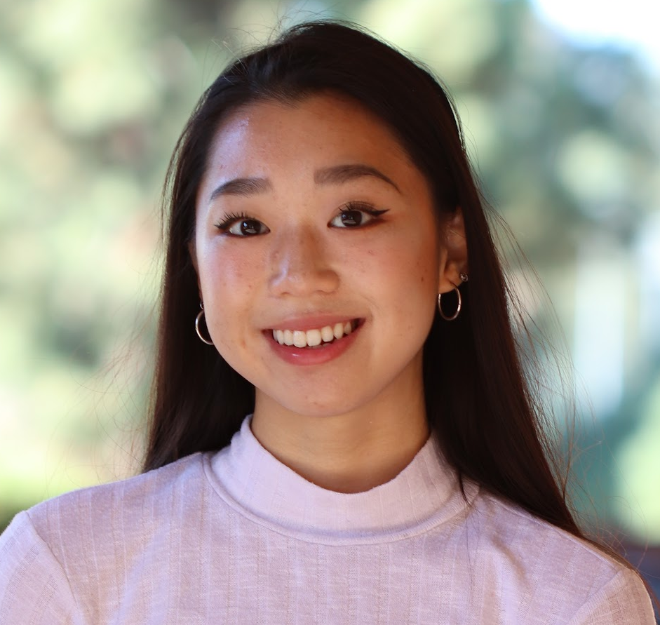
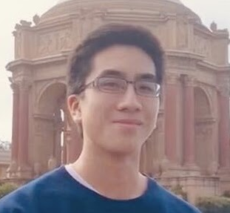
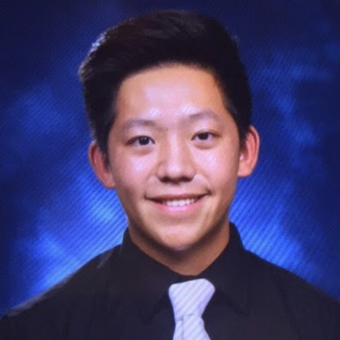
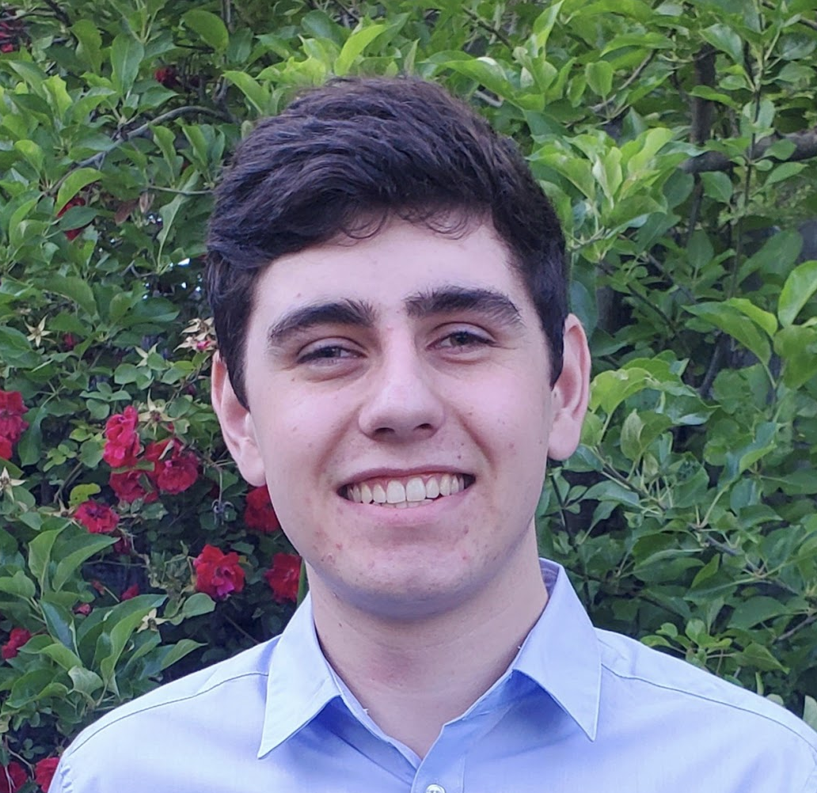
BREANA LEE
EVELYN WAN
ANDREW CHANG
WILLIAM TSAI
FISCHER SHERROD
Social Media Director
3rd Year ChemE
Marketing Director
3rd Year Enviro
Studies
Membership Director
3rd Year Biochem
Finance Director
3rd Year ChemE
Programming Director
2nd Year Math of Computation

Slide 10


JOIN US TODAY! Apply for a board position

Slide 11
Administrative Director
Programming Director
ROLES AND RESPONSIBILITIES
Take attendance and notes at weekly meetings
Compose and send the weekly email newsletter to members
Manage room booking, venue bookings, and catering orders
Maintain and update the REA events calendar and google calendar
Average Weekly Time Commitment: 5 hours
Spearhead one event or more per quarter
Attend one to two tabling events per quarter to represent REA
Assist board with event planning through logistical and media support
Prepare for upper board positions by learning through experience
Average Weekly Time Commitment: 5 hours
APPLY HERE:

Slide 12
03
Projects

Slide 13
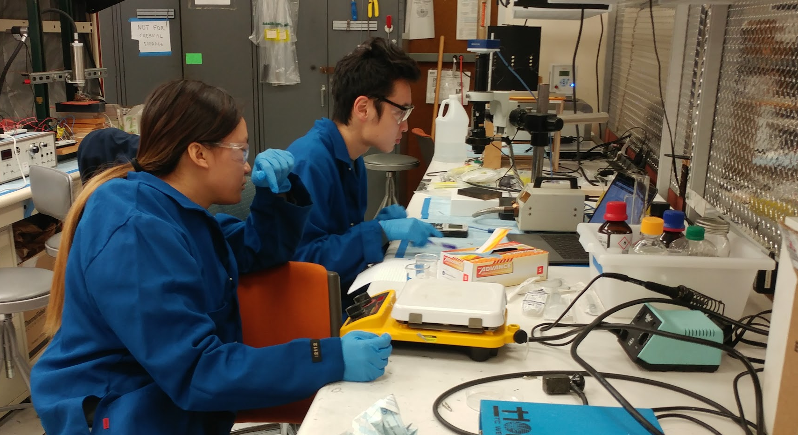
BIODIESEL PROJECT
Educate students about biodiesel as a form of renewable energy through hands-on experience
Convert waste oil from UCLA’s kitchen facilities into useable biodiesel
Research pretreatment of waste oil and biodiesel conversion process in lab
Build prototype reactor to begin large-scale biodiesel conversion
Notes:
Make sure to specify the people are actual members in lab

Slide 14
BIODIESEL TEAMS
EXPERIMENT
PRETREATMENT
REACTOR
Tests industry-standard biodiesel conversion process
Work in lab to test the biodiesel conversion process from pretreated waste oil
Design experimental procedures and SOPs to execute in the lab
Research different pretreatment methods to reduce free fatty acids in the waste oil
Design and execute procedures to test these pretreatment methods in the lab.
Design a small-scale prototype batch reactor that automates biodiesel conversion process and simulates larger biodiesel plant.
Notes:
Albert-Just say the current industry method of pretreatment, with acid is dangerous and environmentally damaging. We’re finding alternatives for pretreatment.

Slide 15
BIODIESEL ACCOMPLISHMENTS AND GOALS
Accomplishments
Goals
Secured space in Dr. Pilon’s Laboratory
Started tests with coconut coir adsorbent pretreatment method
Successfully converted samples of dining hall waste oil into biodiesel
Established framework of reactor units
Raised thousands in funding to build the reactor
Further test industry standard pretreatment and oil-to-biodiesel processes
Test experimental pretreatment methods against industry standards
Begin large-scale biodiesel conversion with the reactor
Leads: Albert Ma and Min Sang Cho
Contact: albertwma@hotmail.com, minsangcho19@gmail.com
First meeting: October 20, Tuesday, 7PM

Slide 16
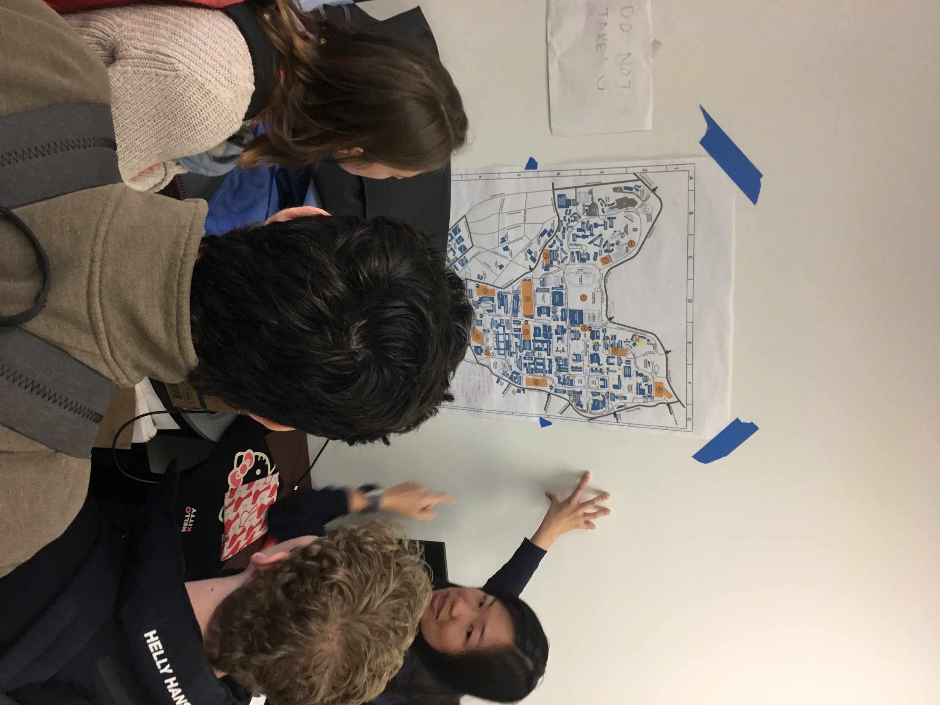
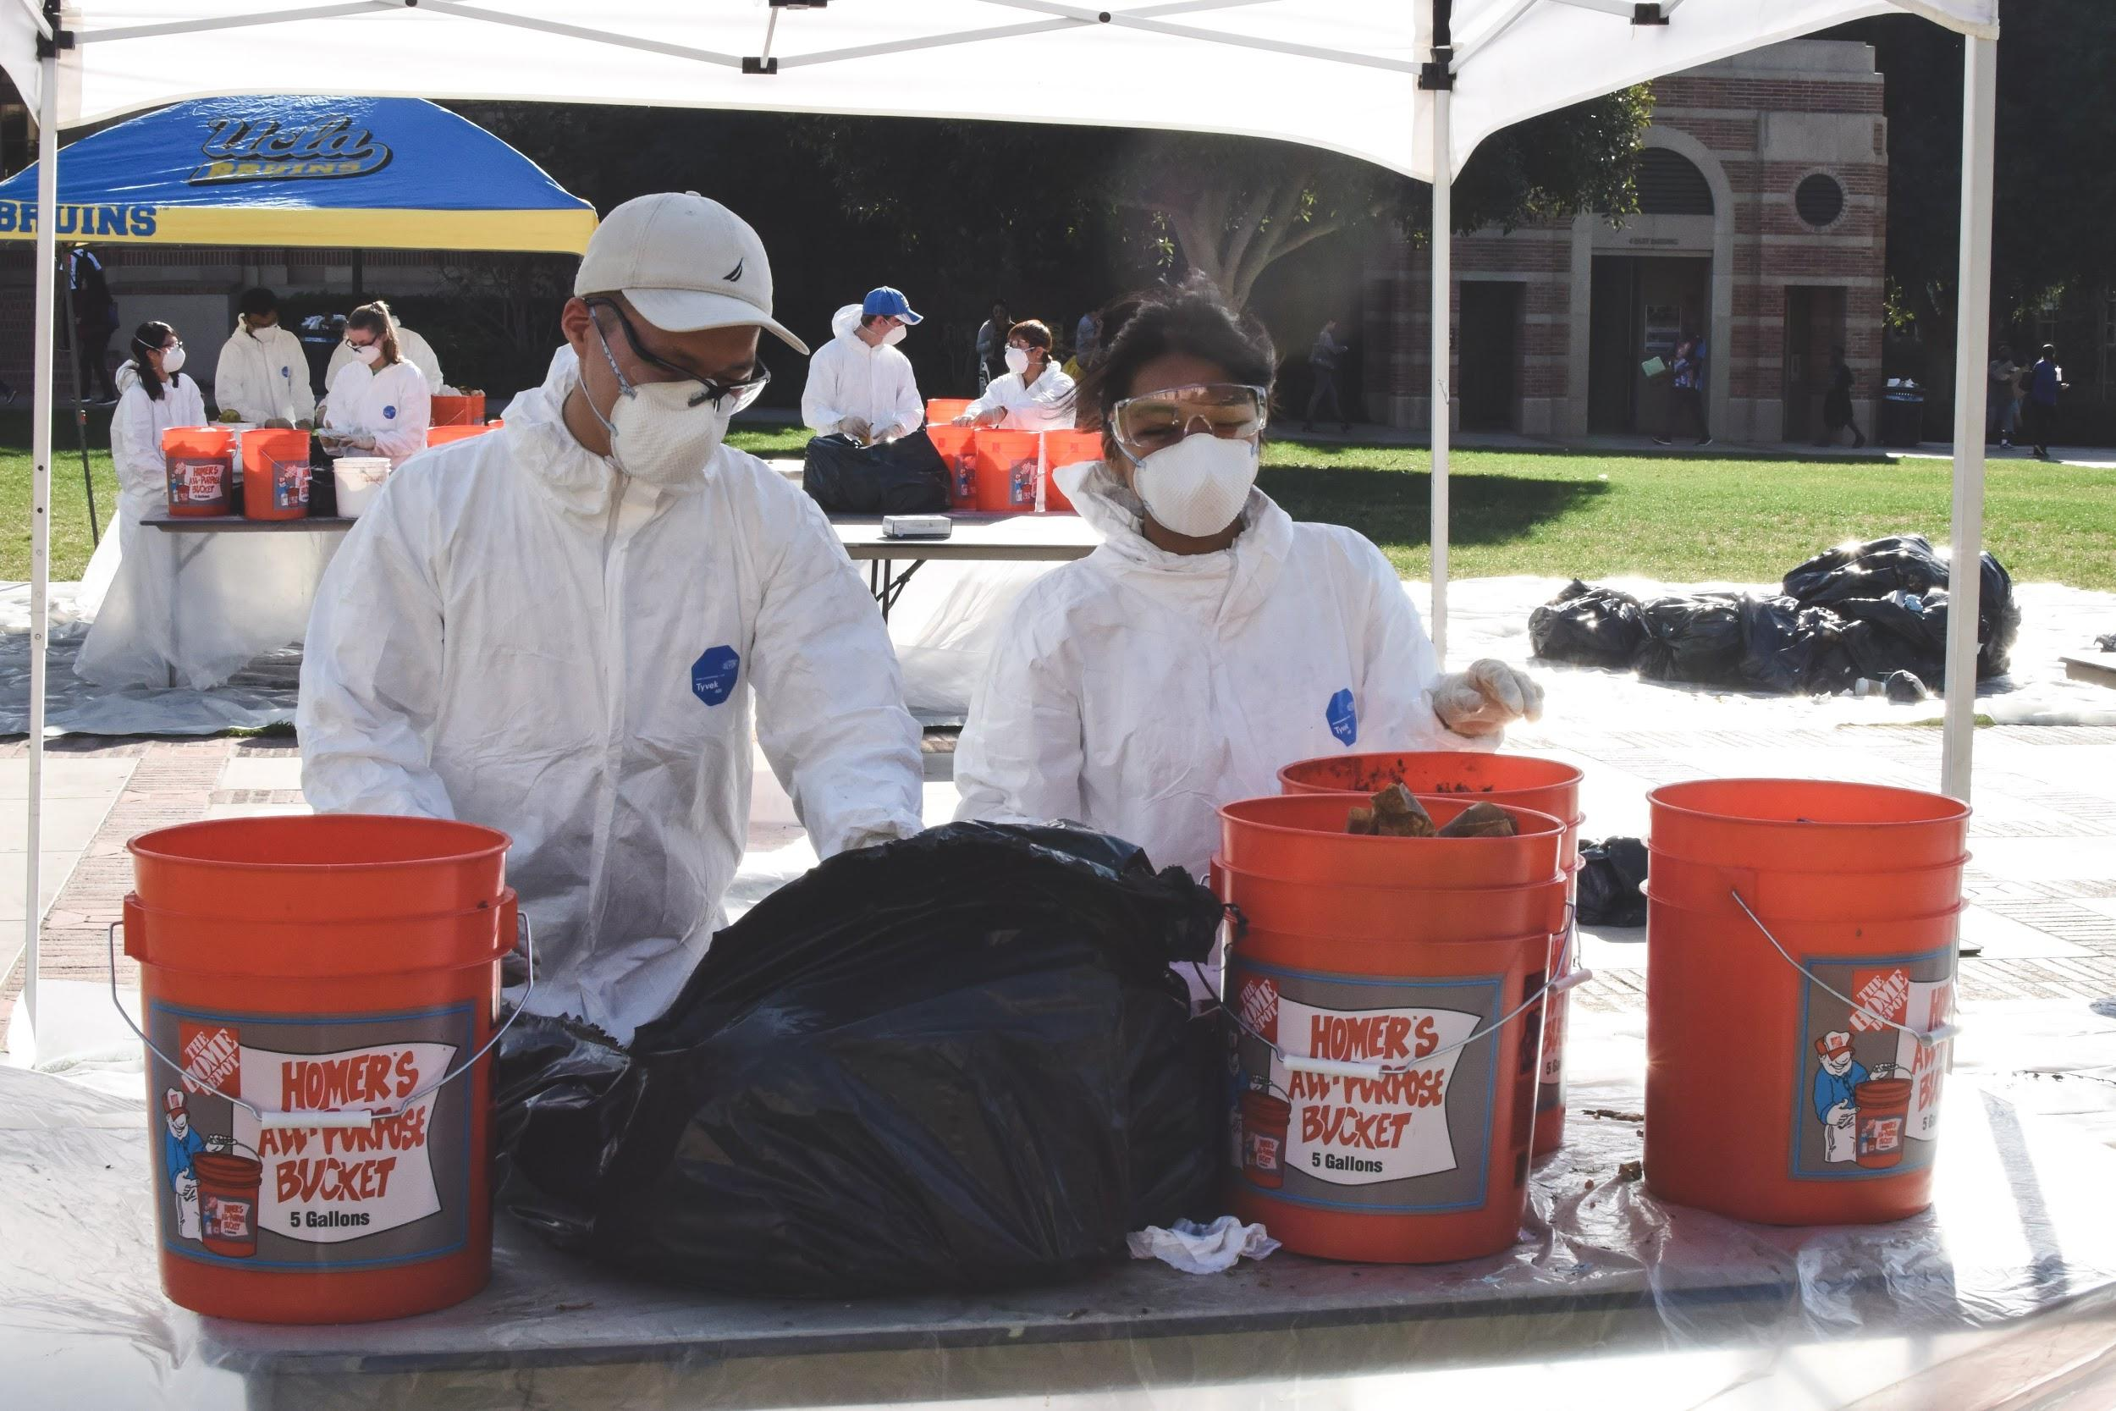
RENEWABLE NATURAL GAS
Educate students about biogas as a form of renewable energy through hands-on experience
Study the effectiveness of UCLA waste reduction and sorting through data analysis
Research the effectiveness of a biodigester to generate energy from UCLA food waste
Propose systematic changes to waste processing and energy generation at UCLA in an end-of-year report

Slide 17
RNG TEAMS
BIOGAS
COMPOST
WASTE PROCESSING
Designs and executes experimental procedures testing the efficiency of the HomeBiogas digester
Collaborates with an industry sponsor to secure professional training for the equipment used to test the biodigester
Collaborate with UCLA Sustainability Action Research to test the effectiveness of organic compost to commercial fertilizer
Explores and establishes use of moisture sensors to collect real-time data
Conduct audits to study the effectiveness of UCLA waste reduction and sorting
Assesses the success of campus waste diversion campaigns through analyzing audit data
Creates a cumulative end-of-year report on the energy potential of UCLA’s organic waste

Slide 18
RNG ACCOMPLISHMENTS AND GOALS
Accomplishments
Goals
Partnered with Student Action Research to study the viability of replacing synthetic fertilizer with compost
Finalized bin selection, sorting procedures, and safety standards for the upcoming campus-wide audit
Completed biodigester equipment orders and developed final testing procedures
Developed a 10-week workshop program to provide members with in-depth skills in organic waste management and RNG technologies
‣ Host educational workshops on a variety of topics and software used within the renewable natural gas sector
‣ Begin testing the efficiency of the biogas digester on campus
‣ Digitize and update the map of campus waste streams using GIS
‣ Create a cumulative end-of-year report on the energy potential of UCLA’s organic waste
Leads: Chirine Chidiac & Coco Nakano
Contact: cchidiac@g.ucla.edu & ikukonakano8@gmail.com
First meeting: Tuesday, Week 2 at Time TBD

Slide 19
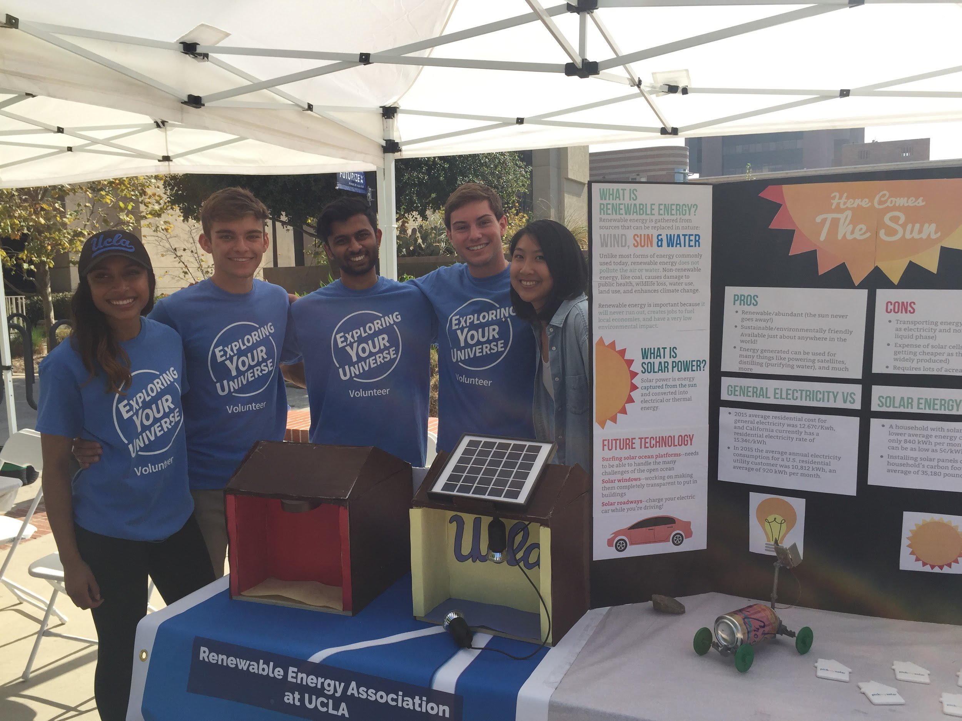
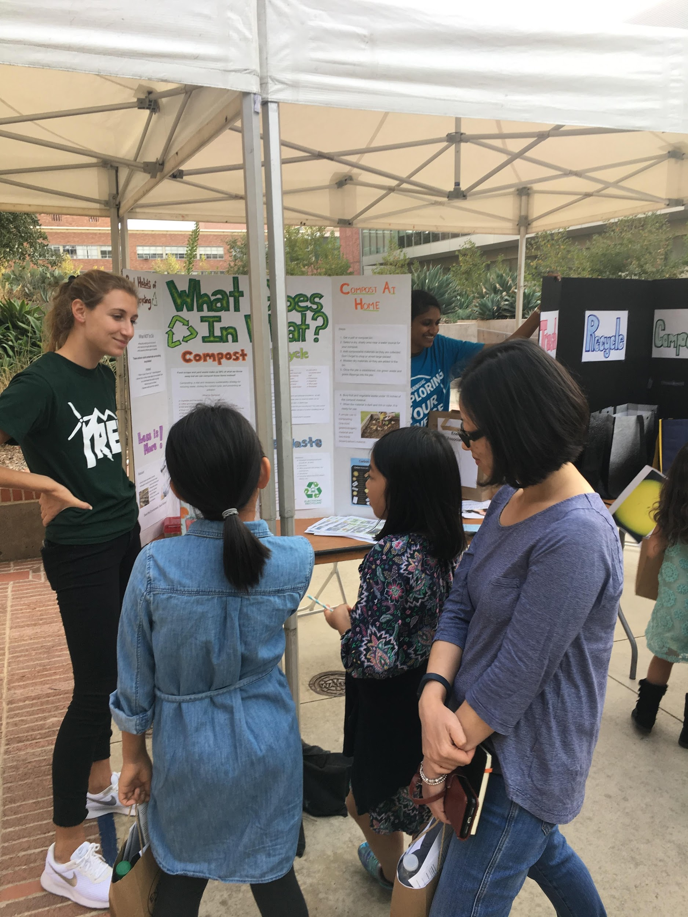
LEARN & TEACH
Inspire the next generation of sustainability advocates
Provide access to sustainability issues in underrepresented areas
Learn how to communicate technical knowledge to those with little technical background
Encourage young students to delve into the fields of renewable energy and sustainability

Slide 20
LEARN AND TEACH ACCOMPLISHMENTS AND GOALS
Accomplishments
Goals
‣ Presented at the UCLA Lab School, WorldSpeak School, LA Family Housing, and Sotomayor Learning Academy
‣ Presented at Engineering Kids Day, Engineering Week, and the Explore Your Universe fair for 3 consecutive years
‣ Partner with new schools to provide renewable with more students, particularly in underserved communities
‣ Expand the renewable energy curriculum for interdisciplinary, on-campus UCLA events
Leads: Patrick Ma and Kavitha Ambatipudi
Contact:
First meeting:

Slide 21
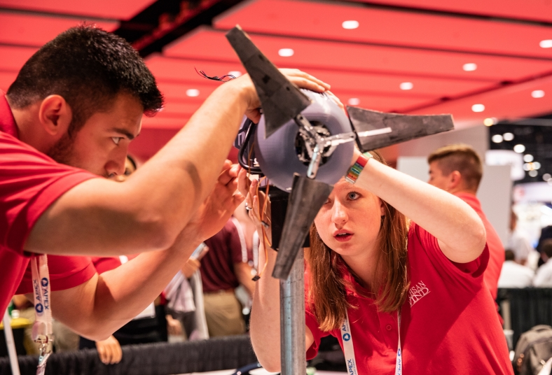
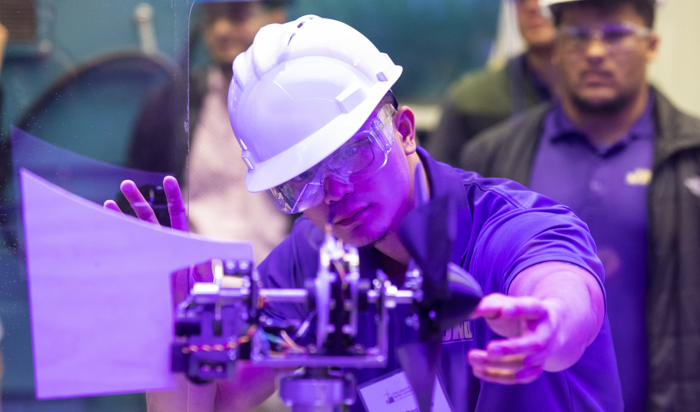
WIND PROJECT
Construct a functional wind turbine system to compete in the annual Collegiate Wind Competition(CWC)
Develop technical skills through hands-on engineering experience
Educate students on the environmental and economic potential of wind energy

Slide 22
WIND TEAMS
Mechanical Design
Blade Design
Electrical Controls
Design nacelle structure, motor hub, and housing
Conduct structure analysis on turbine
Construct turbine using machining techniques
Analyze and optimize blade geometries
Develop yaw system for wind turbine orientation
Select blade material and manufacturing process
Design generator in parallel with electrical system
Optimize system’s energy production
Implement hardware for controling output

Slide 23
UPCOMING GOALS
Develop a basic mechanical and electrical wind turbine system prototype
Construct a dynamometer used to test turbine motor and drivetrain
Secure funding, sponsors, and partners
Prepare written proposals to compete in Collegiate Wind Competition
Lead: Tim Chao
Contact: timc8932@gmail.com
First meeting: Oct 14th 7:00pm

Slide 24
04
Events

Slide 25
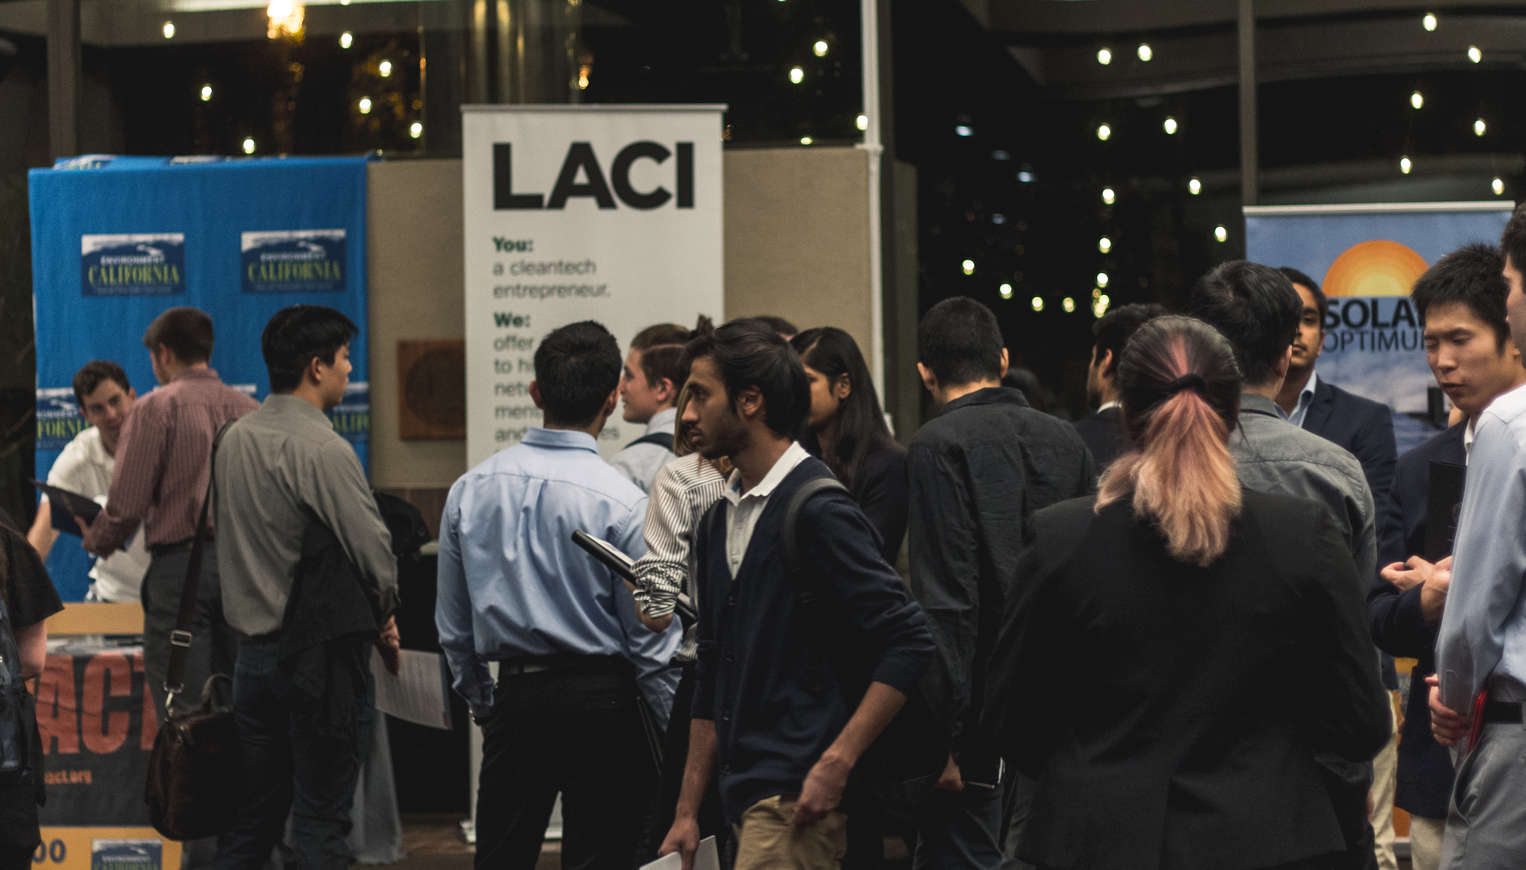
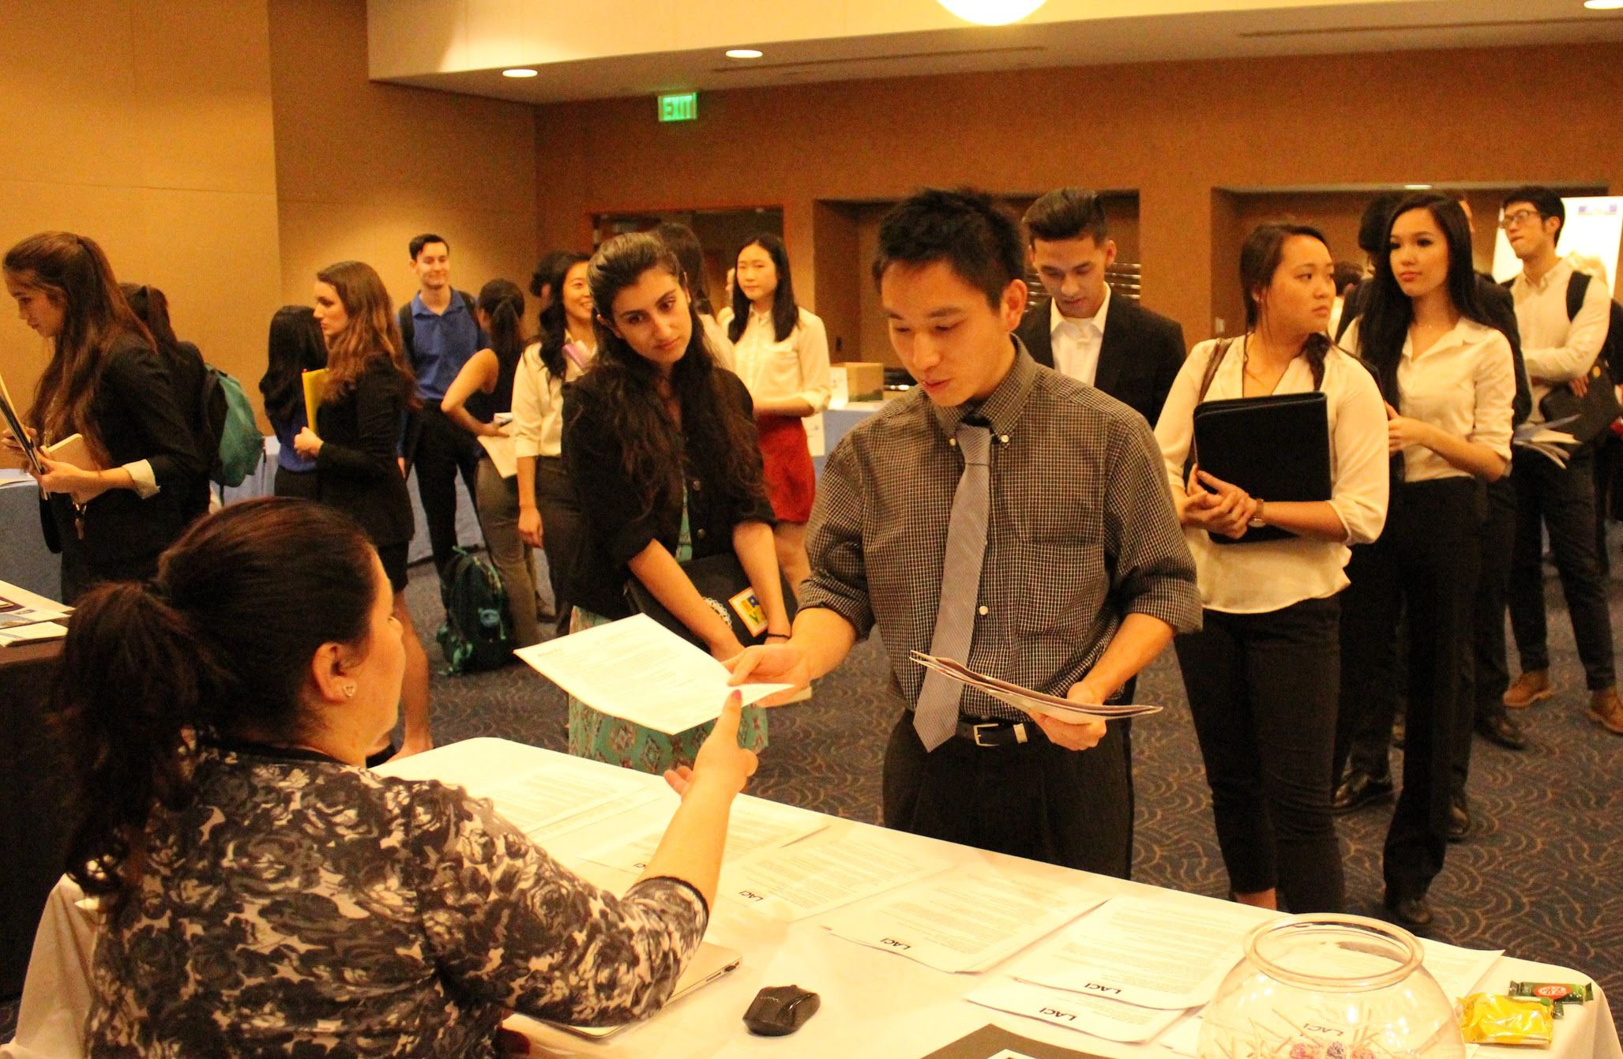
ENERGY JOBS FAIR
One of the largest student-run, energy-specific professional jobs fairs in Southern California
Showcases careers at the intersection of engineering and sustainability, with a focus on renewable energy
Provides students with the opportunity to network with professionals in the energy industry

Slide 26
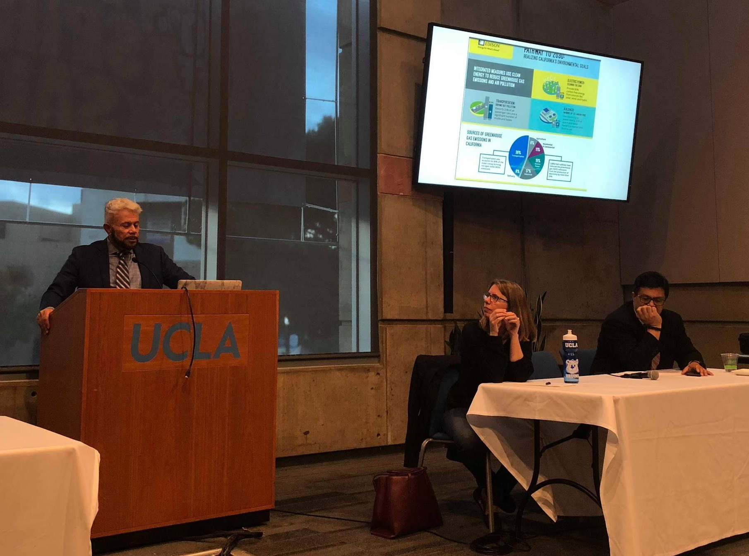
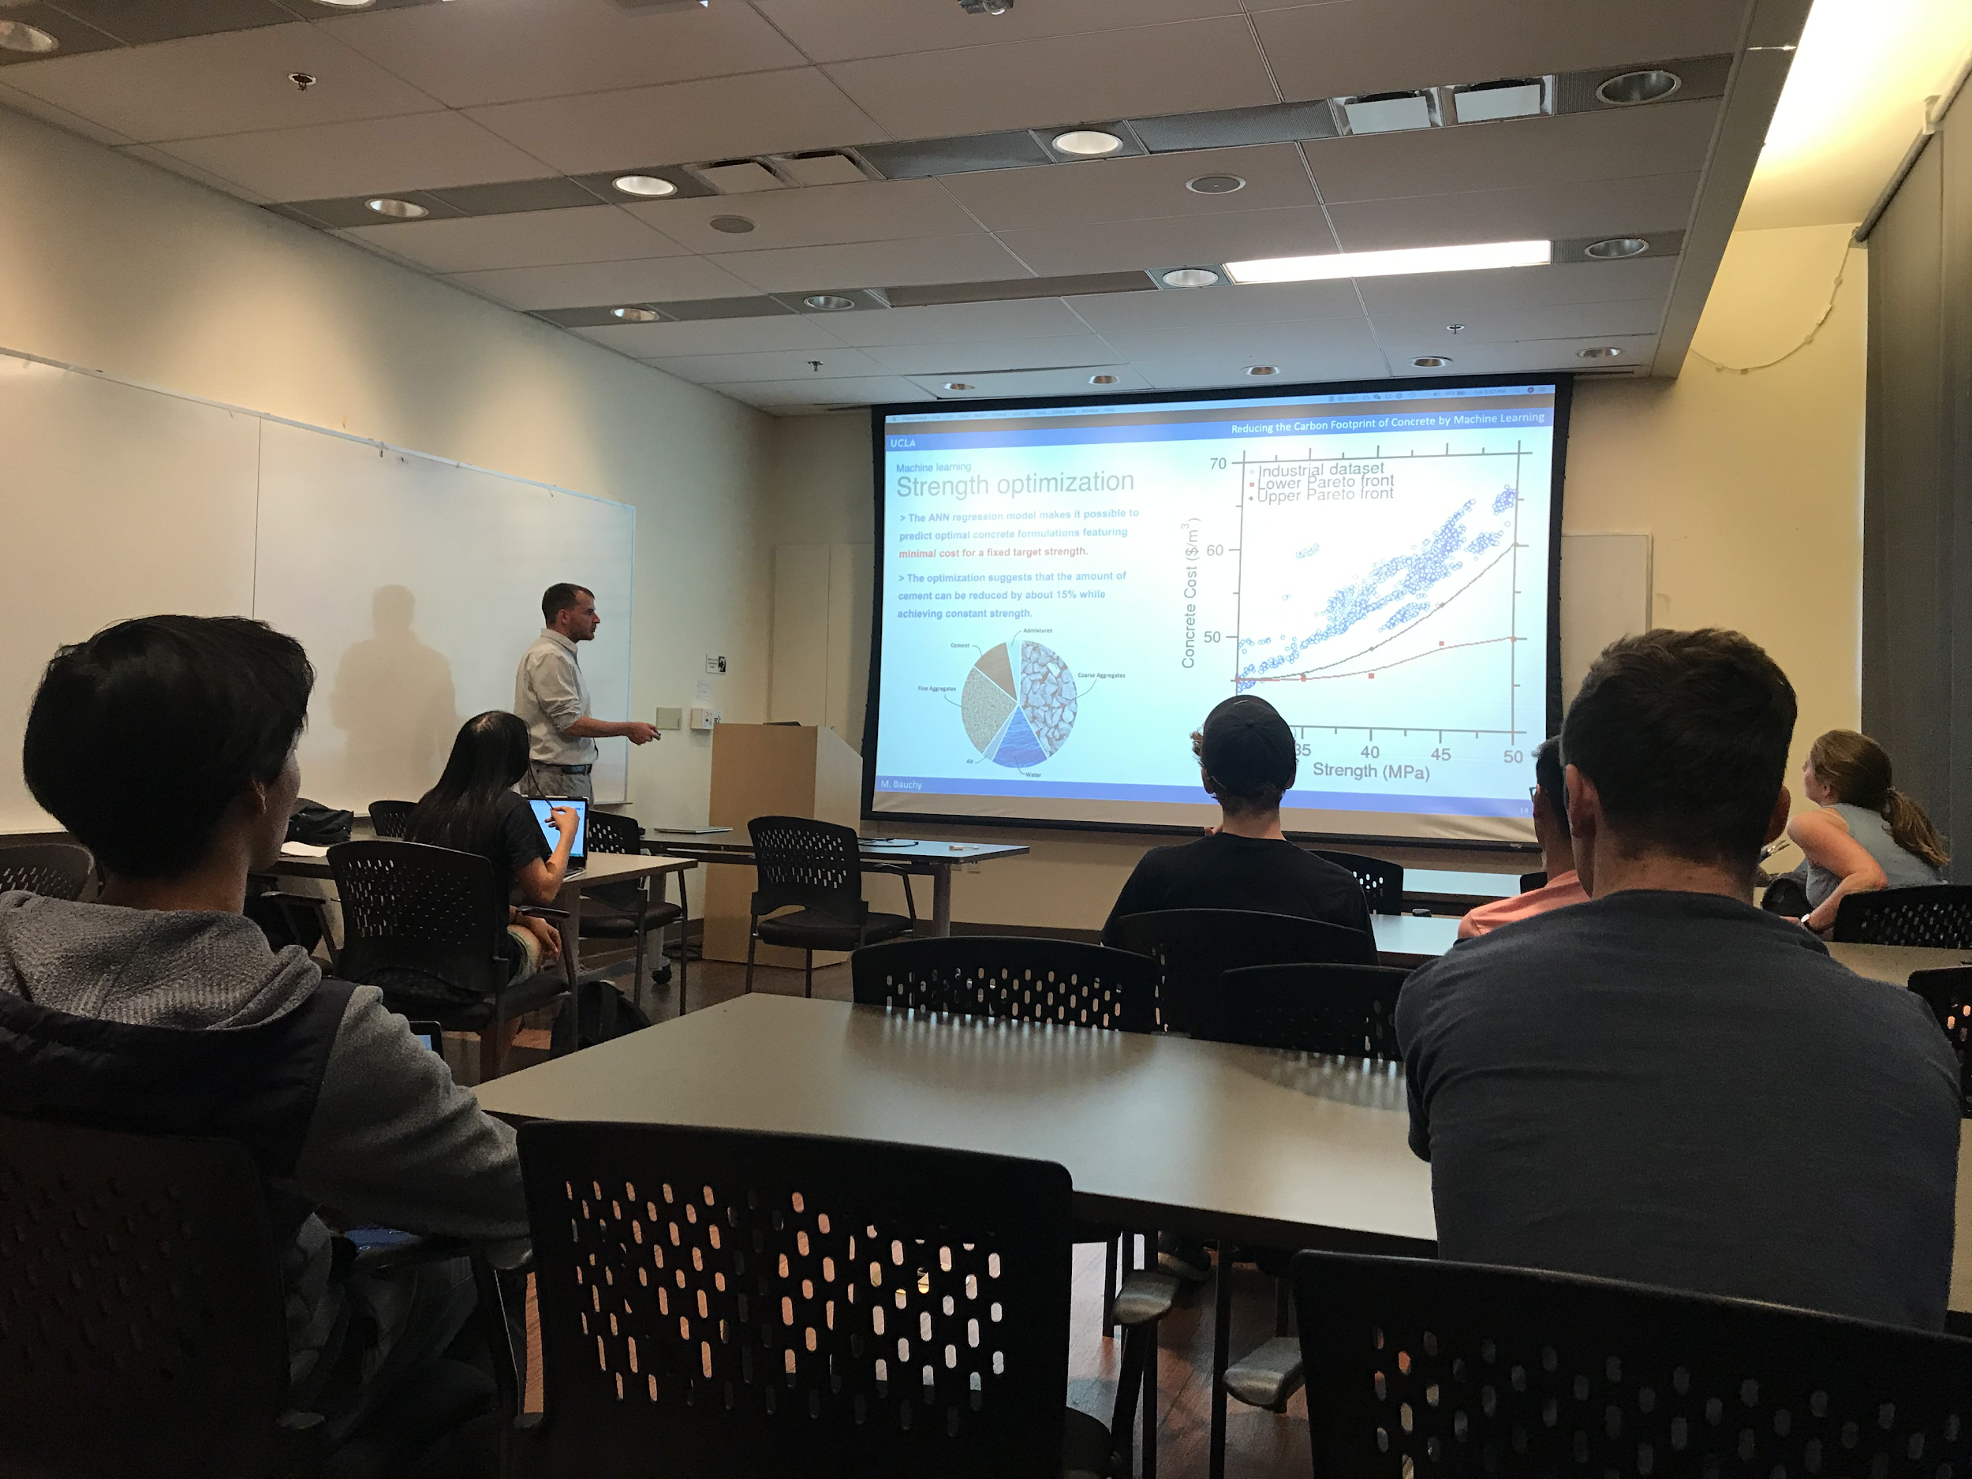
RESEARCH AND POLICY PANELS
REA invites a panel of UCLA professors whose research is at the forefront of modern advances in environmental sustainability.
REA also invites policy makers and journalists to talk about the various environmental policies being enacted in LA and around the world

Slide 27
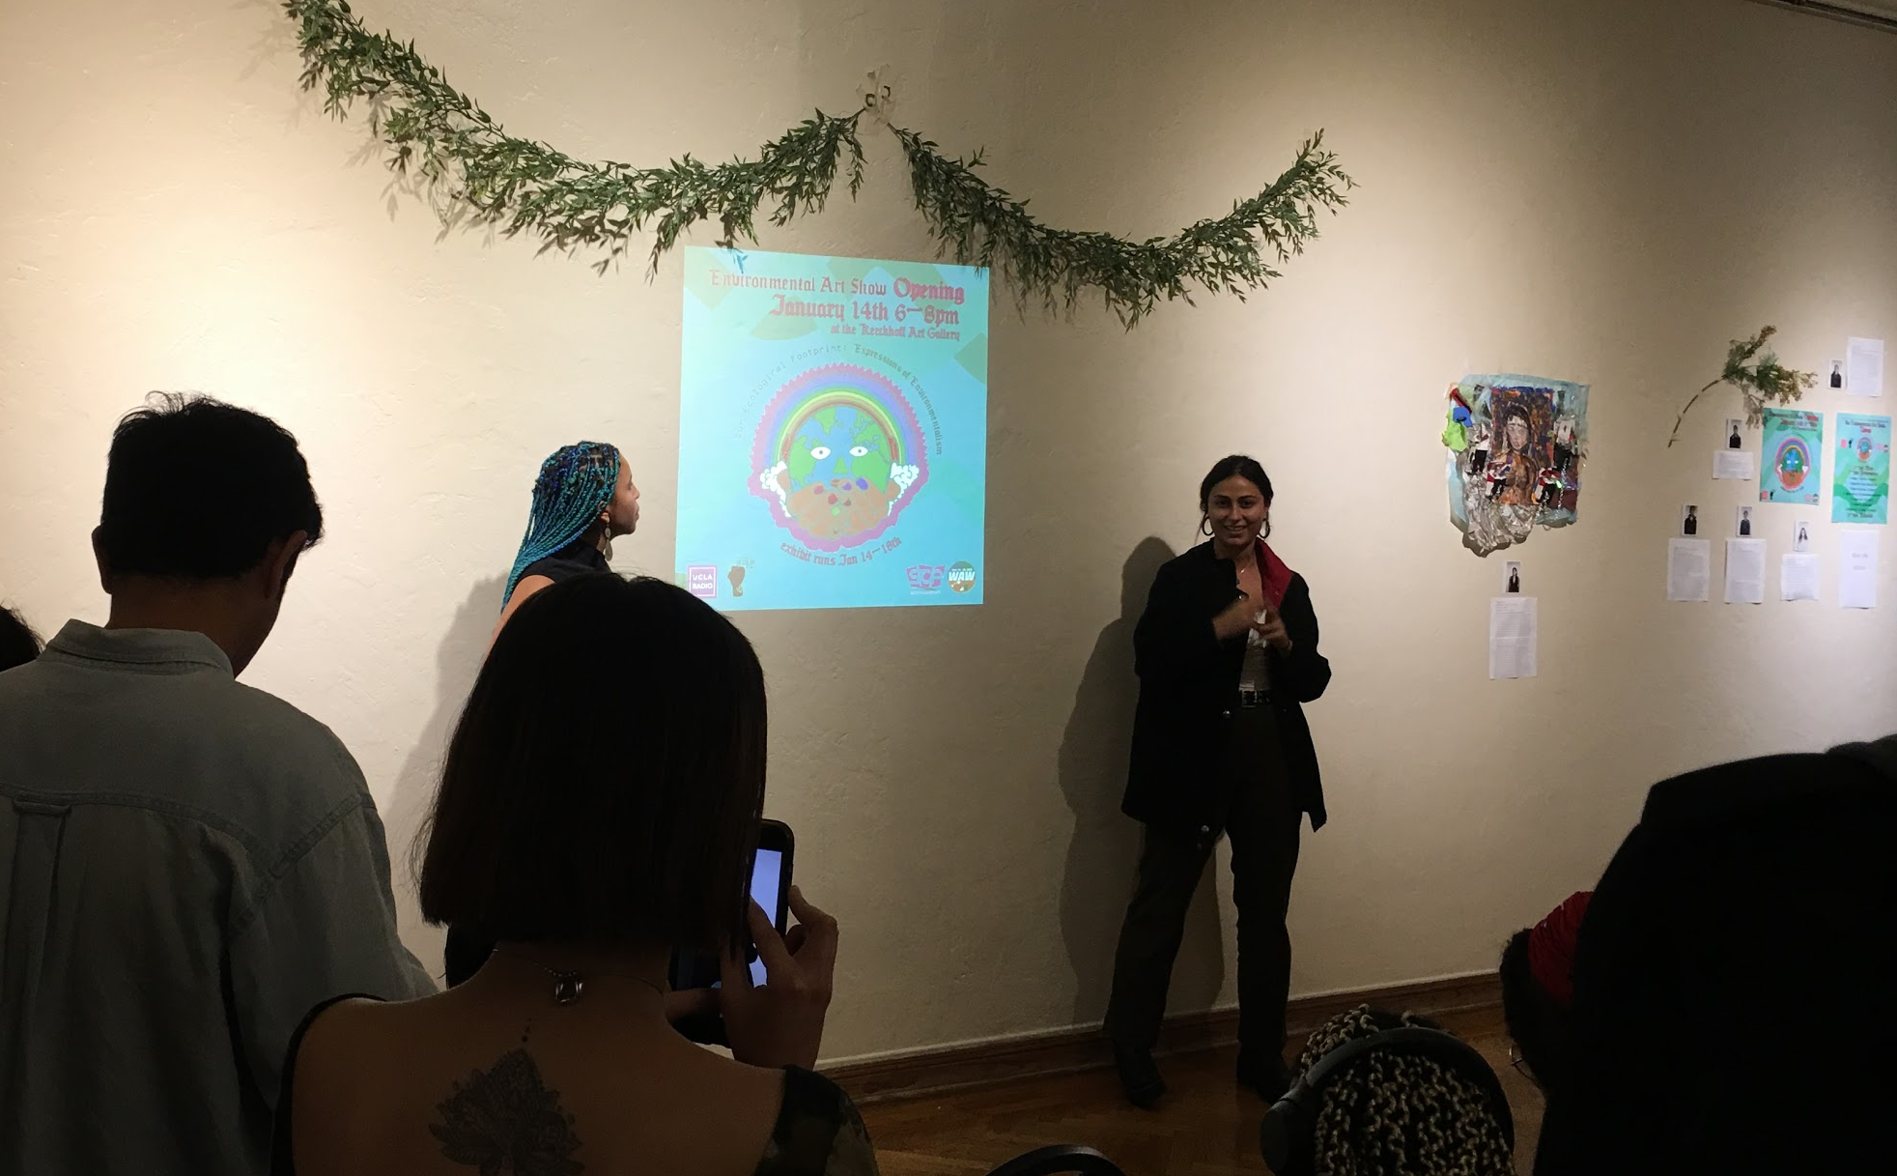
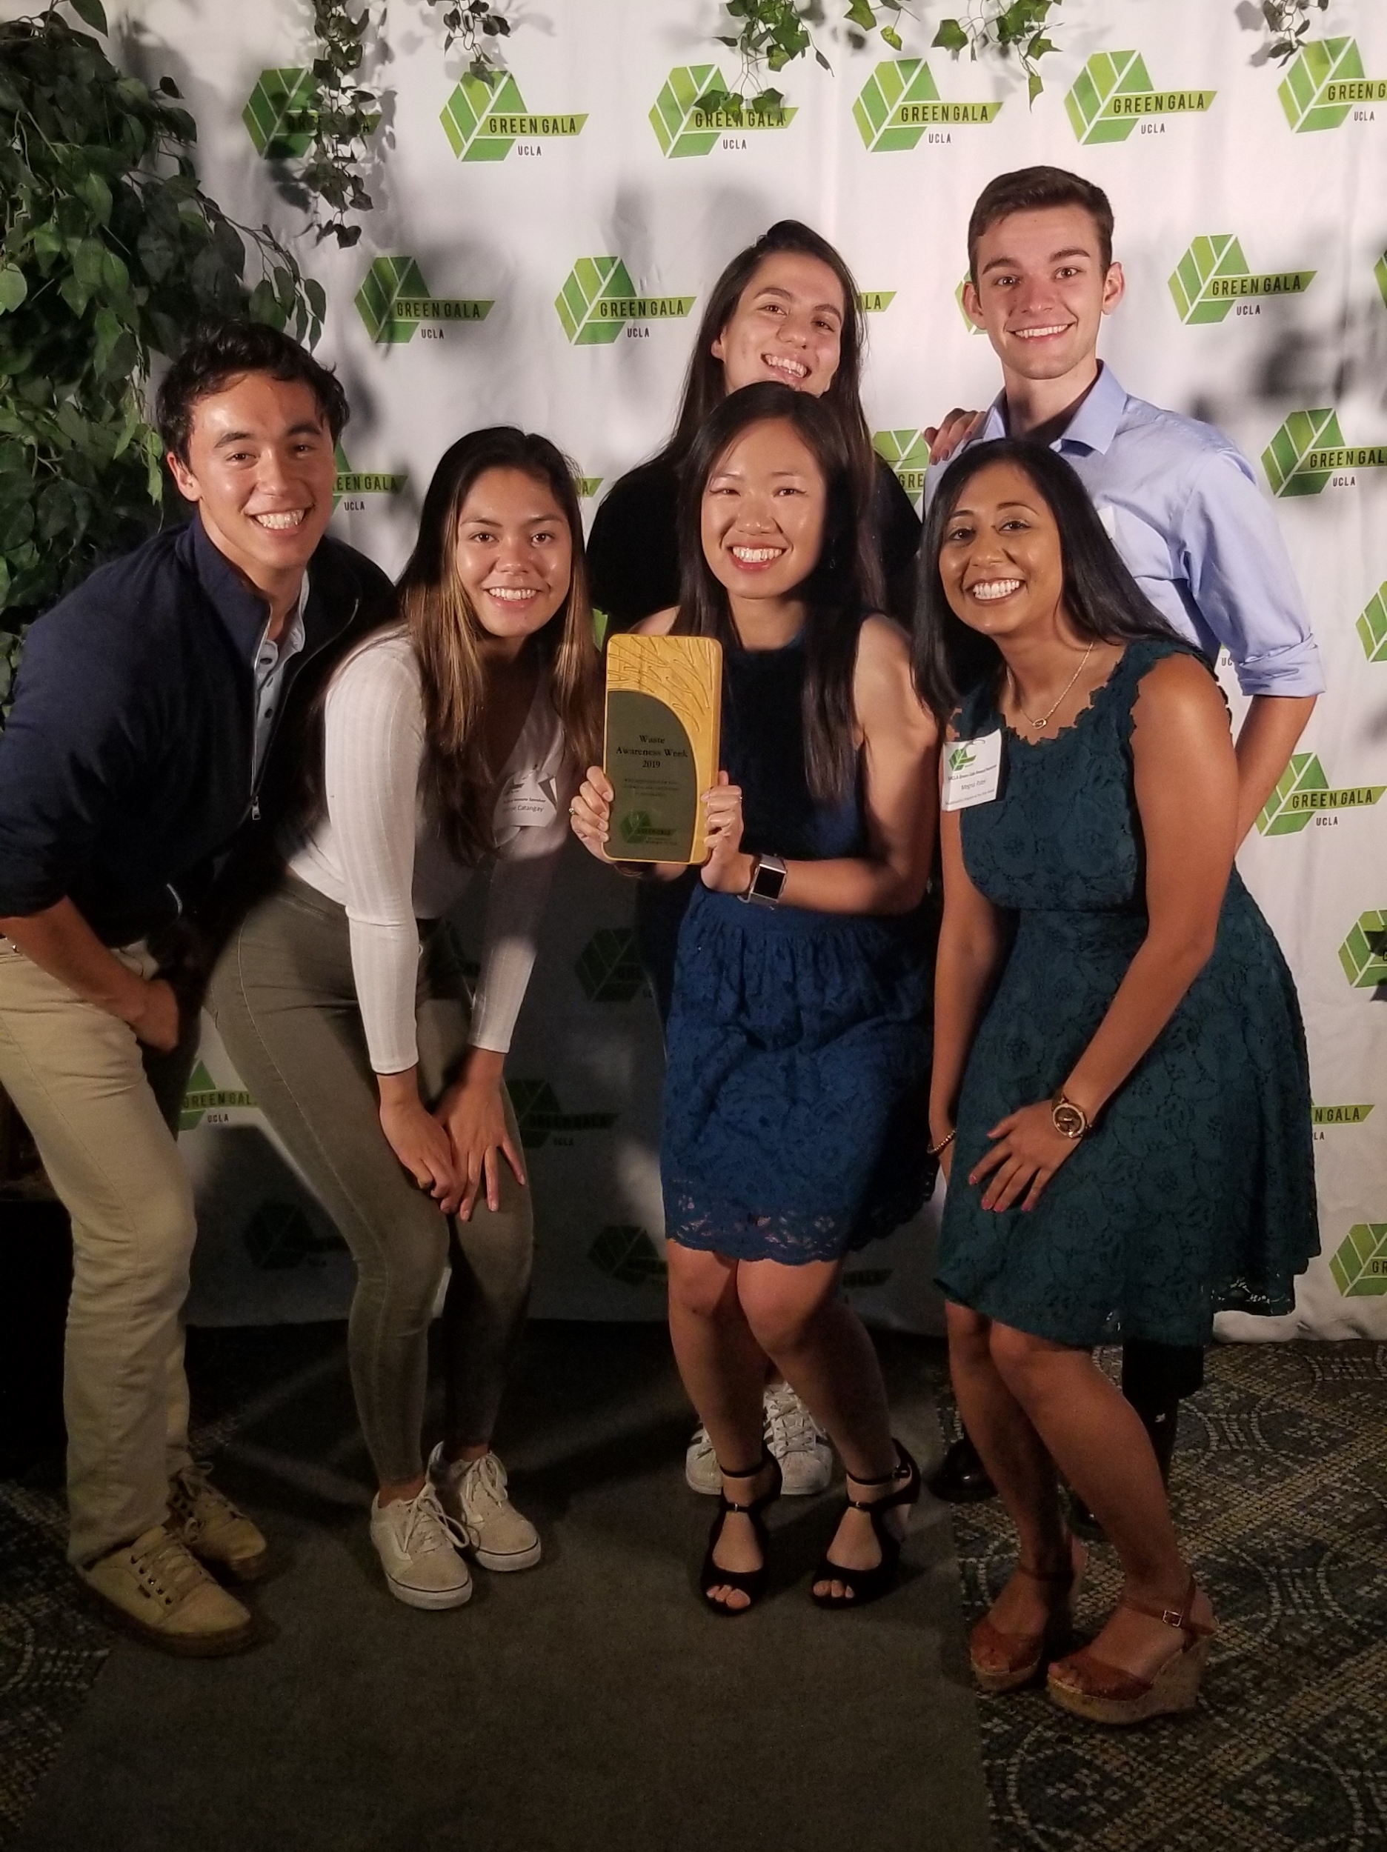
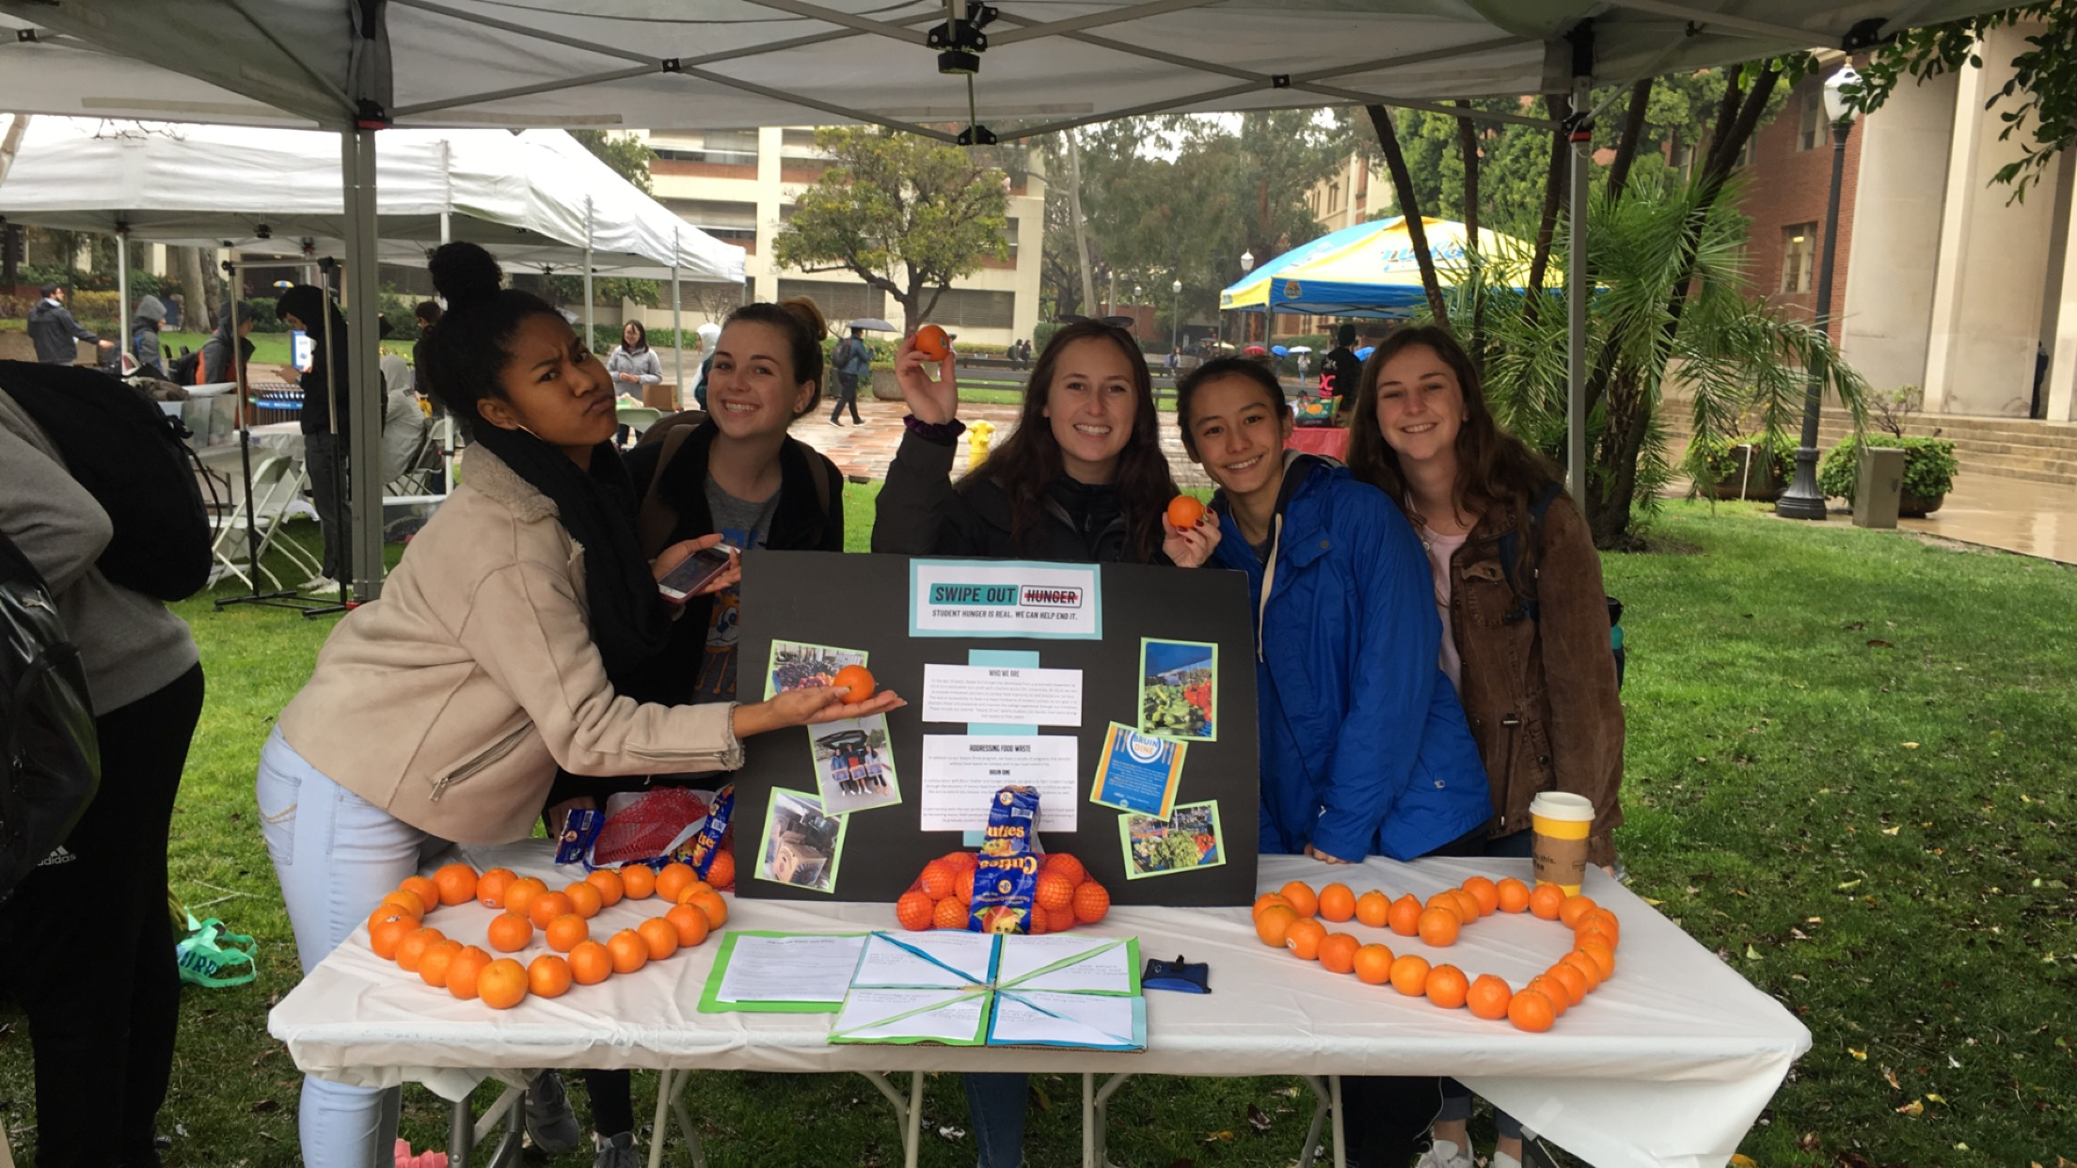
WASTE AWARENESS WEEK
Week-long sustainability event that specifically tackles the impact of waste mismanagement on the environment
Consists of a large variety of events from interactive games, workshops, to collaborative art shows, movie screenings and swap meets
Aim to expose students to the gravity and scale of the global waste crisis

Slide 28

Thanks!
Do you have any questions?
]]
uclarenewable@gmail.com
https://www.rea.seas.ucla.edu

Slide 29
OUR PARTNERS
VENUS | MARS | JUPITER
Venus has a beautiful name and is the second planet from the Sun | Despite being red, Mars is actually a cold place. It’s full of iron oxide dust | Jupiter is a gas giant planet and the biggest planet in our Solar System
PARTNER | PARTNER | PARTNER

Slide 30
ALTERNATIVE RESOURCES

Slide 31
ALTERNATIVE RESOURCES

